Slide 1
ADHD
Melissa N. Moyer
Notes:
Hi, my name is Melissa for those of you who don’t know me, and today I’m going to be talking to you about ADHD. Both my younger brothers are part of the five to ten percent of school-aged children affected by ADHD.

Slide 2
The Three Types of ADHD
Predominantly Inattentive
Predominantly Inattentive
Predominantly Hyperactive/Impulsive
Combined Type
Avoids difficult tasks
Failure to:
Pay attention to details
Keep track of things
Follow instructions
Keep organized
http://www.help4adhd.org/en/treatment/guides/dsm
Notes:
There are three major types of ADHD which are Predominantly Inattentive, Predominantly Hyperactive or Impulsive or a Combined type. For an official diagnosis, the child must display at least six out of the list of symptoms associated with ADHD types. First, Predominantly Inattentive Type. These ADHD patients typically avoid difficult tasks, and usually have a hard time paying attention to details, keeping track of things, follow instructions or keep organized. This is a lot like my brother Zach, and if you look his room, you’d have no doubt. Not that mine is much better.

Slide 3
The Three Types of ADHD
Hyperactive/Impulsive
Predominantly Inattentive
Predominantly Hyperactive/Impulsive
Combined Type
Fidgety, having a difficult time remaining seated
Excessive talking with Tendencies to interrupt people
Difficulty engaging in quiet activities
http://www.help4adhd.org/en/treatment/guides/dsm
Notes:
Second is predominantly hyperactive/impulsive. These children and adults have a difficult time remaining seated, and are often fidgety. They also talk excessively and have a tendency to interrupt people, and often have a hard time engaging in quiet activities. My youngest brother Nick, is a lot like this. For example, he has a hard time sitting down for dinner, he constantly jumps up and runs around, and if he wants to say something, he interrupts anyone who’s talking.

Slide 4
The Three Types of ADHD
Combined Type
Predominantly Inattentive
Predominantly Hyperactive/Impulsive
Combined Type
As suggested, this is when the individual displays signs of both Hyperactive/Impulsive type as well as Inattentive type symptoms
http://www.help4adhd.org/en/treatment/guides/dsm
Notes:
Combined type, as suggested, is when the individual has some or all symptoms from both Predominantly Inattentive type and predominantly hyperactive/impulsive type. It makes me happy that I only have two brothers.

Slide 5
Emotions
ADHD patients often have issues with:
Hot temper
Unpredictable shifts toward negative emotions
Depression
Anxiety
Substance abuse
If left unattended it can lead to long term functional impairment and may not go away.
As the severity of the ADHD increases so do these potential problems.
Banaschewski et al.
Notes:
Emotions run high with any disease, but in ADHD patients, they often have issues with Hot tempers, unpredictable shifts toward negative emotions, depression, anxiety, and substance abuse. There is a direct correlation between the severity of ADHD and the risk of dealing with these issues. If left unattended these problems can lead to long term functional impairment and may not go away. It can also become very hard on siblings and parents. Right now Nick is struggling with depression, hot temper, and often can suddenly become very negative and upset if you say the wrong thing around him. It’s created a lot of fights, but we’ve been taking steps in order to get him help before it becomes more of a problem.

Slide 6
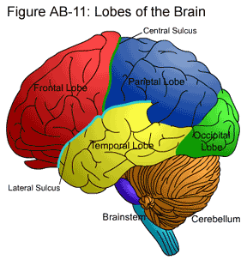
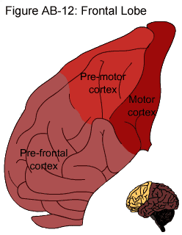
The Brain
Stanford.edu
Notes:
In a moment I will be talking about the Prefrontal cortex in ADHD patients. The pre-frontal cortex is located in the Frontal lobe, near the front of the brain, seen here.

Slide 7
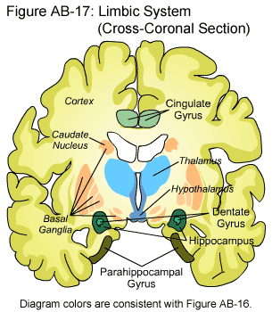
The Brain
Executive functions:
Thalamus
Basal Ganglia
Cerebellum
Prefrontal Cortex
MRI studies show that ADHD patients have a less dense prefrontal cortex.
Stanford.edu and Bidwell et al.
Notes:
It, along with the Thalamus, Basal Ganglia, and Cerebellum control Executive functions. It is believed to be mainly the Prefrontal Cortex that controls the executive functions however. The problem is in ADHD patients MRI studies show that these people have a less dense prefrontal cortex. In other words, there aren’t as many neurons or synapses in these areas.

Slide 8
Circadian Clock
Several Genes affected
ARNTL2
NPAS2
RORA
FNT
These are just a few of the affected Circadian Clock genes.
Responsible for day to day functions.
ADHD patients have a disrupted Circadian Clock
McCarthy et al.
Notes:
The Circadian Clock is responsible for day to day functions, it helps you decide when to get up and when to go to bed. It helps to remind you that it’s time to eat. The Circadian Clock also helps you get ready for seasonal changes; it tells the bears when they need to hibernate. In ADHD patients, their Circadian Clock is disrupted, and can offset them by at least five hours. There are at least thirteen genes that help maintain the Circadian clock, these are just four of the effected genes.

Slide 9
Medication
Methylphenidate
Stimulant
Usually effective
Causes a lot of side effects
Buspirone
Non-stimulant
Less effective
Less side effects
Mohammadi et al.
Notes:
As with any disease, medication is a big issue. You need to know what medication works best for the patient, and there can often be a lot out there that works. Contrary to its name a stimulant helps to make nerves to communicate better rather than increasing stimulation. Mahammadi et al studied a stimulant known as Methylphenidate, which is found in Ritalin, as well as Buspirone (Byue-spy-row-n) which is a non-stimulant. In their study they looked at twenty children in a double-blind test. Recall that a double blind test is when neither the doctor nor the patient knows the medication that they’re on. Before I continue I’d like to point out that there was an error in table two. They listed Busropion as the drug they gave as opposed to Buspirone in table one. Busropion actually treats depression and aids in quitting smoking while Buspirone mainly treats anxiety. The side effects that they looked at in this study was Abdominal pain, Dizziness, Decreased appetite, Tics , Insomnia, Dry mouth, headache, and vomiting. Tics, for those of you who haven’t heard this before, is an involuntary action, like excessive blinking, or odd facial movements – my brother Zach has a tendency to make a fish face. As you can see from the chart, Buspirone only differed from Ritalin in decreased appetite, insomnia and headaches. The decreased appetite and tics are side effects Zach deals with the most. Nick, on the other hand has trouble with headaches. The problem is that compared to Methyphenidate, Buspirone is less effective in controlling ADHD symptoms.

Slide 10
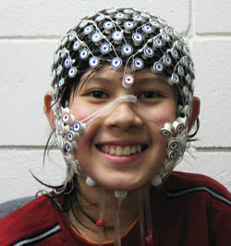
EEGs
Measure electrical activity of nerves from the scalp
Each electrode can measure hundreds of signals
Ethically wrong to stick electrodes directly on the brain unless you’re having open brain surgery
Child and family Center.
Notes:
In the last study we will look at, they used an EEG, or electroencephalography, which measures the electrical signals of nerves under your skin. These can be placed directly on the scalp and can measure hundreds of thousands of signals at one time. They can also be placed into the brain to measure electrical activity of individual nerves, but it is ethically wrong to do this to humans unless you’re preforming open brain surgery for another reason. It has, however, been done to animals in the past. In humans, an EEG is less stressful, non-invasive, and is generally easier to perform on a child.

Slide 11
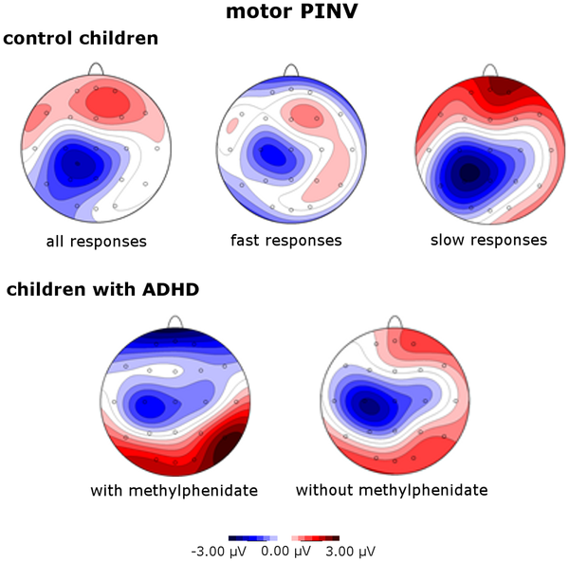
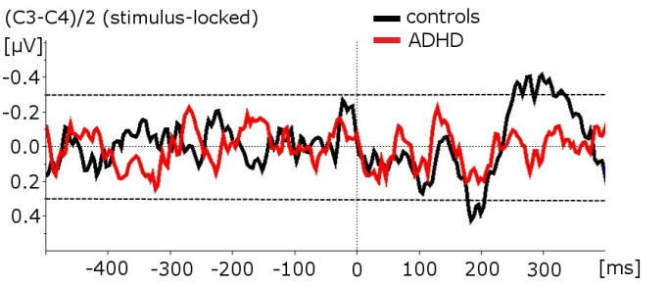
Not Quite the Same
Multiple Electrode EEG
Single Electrode EEG
Bender et al.
Notes:
The main take away message from this slide is that even with medication, ADHD patient’s brains are not the same. As you can see from the multiple electrode EEG, looking at the “All Responses” section it is negative here (circle with pen) and positive here (circle with pen). This is a typical response. In the children with ADHD, on medication the areas that are positive and negative are almost exactly opposite. It is negative here (circle with pen) and positive here (circle with pen). Even without their medication it still is opposite. Now, looking at a single electrode, like we did in lab for the eye movement, you can see the response graph for the control children and ADHD children. There is no correlation between any of the peaks on the graph of the control children verses the ADHD children. This opens the door for further research in trying to regulate Brain activity.

Slide 12
Literature and Resources
"Symptoms and Diagnostic Criteria." CHADD, 2013. Web. 07 Apr. 2013. http://www.help4adhd.org/en/treatment/guides/dsm
Banaschewski T., Jennen-Steinmetz C., Brandeis D., Buitelaar J.K., Kuntsi J., Poustka L., Sergeant J.A., Sonuga-Barke E.J., Fraiser-Wood A.C., Albrecht B., Chen W., Uebel H, Scholtz W., van der Meere J.J., Gill M., Manor I., Miranda A., Mulas F., Oades R.D., Roeyers H., Rothenberger A., Steinhausen H, Faraone S.V., and Asherson P.. 2012. Neruopsychological correlates of emotional lability in children with ADHD. J CHILD PSYCHOL PSYC 53(11):1139-1148
Stanford. Web. 07 Apr. 2013. https://www.stanford.edu/group/hopes/cgi-bin/wordpress/2010/06/the-hopes-brain-tutorial-text-version/ Bidwell L.C., McClernon J.F., and Kollins S.H.. 2011. Cognitive enhancers for the treatment of ADHD. PHARMACOL BIOCHEM BEHAV 99(2):262-274
McCarthy M.J. Nievergelt C.M., Kelsoe J.R., and Welsh D.K.. 2012. A survey of genomic studies suppors association of circadian clock genes with bipolar disorder spectrum illnesses and lithium response. PLOS ONE 7(2):e32091
Mohammadi M., Hafezi P., Galeiha A., Hajiaghaee R., and Akhondzadeh S.. 2012. Buspirone versus methylphenidate in the treatment of children with attention-deficite/hyperactivity disorder: Randomized double blind study. ACTA MEDICA IRANICA 50(11):723-728
Child and family Center. Web. 09 April 2013. http://pages.uoregon.edu/cfc/projects-bbl.htm
Bender ., Resch F., Klein C., Renner T., Fallgatter A.J., Weisbord M., and Romanos M.. 2012. Influence of stimulant medication and response speed on lateralization of movement-related potentials in attention-deficite/hyperactivity disorder. PLOS ONE7(6):e39012
Citations in order of use
Notes:
Any Questions?

